Slide 1
team 33
Personality Prediction System via CV Analysis

Slide 2
project description
It is a challenging task to shortlisting deserving candidates from a massive pile of CVs. What if there’s a software that can interpret the personality of a candidate by analyzing their CV? This will make the selection process much more manageable. This project aims to create advanced software that can provide a legally justified and fair CV ranking system.
The system will work something like this – candidates will register in the system by entering all the relevant details and upload their CV. They will also take an online test that focuses on personality traits and a candidate’s aptitude. Candidates can also view their test results.

Slide 3
Project outcome
The system will rank candidates based on their skills and experience for a particular job profile. It will also consider all other crucial aspects, like soft skills, interests, professional certifications, etc. This will eliminate all the unsuitable candidates for a job role and create a list of the most suitable candidates for the same. Together with the online personality test and CV analysis, the system will create a comprehensive picture of the candidates, simplifying the HR department’s job.

Slide 4
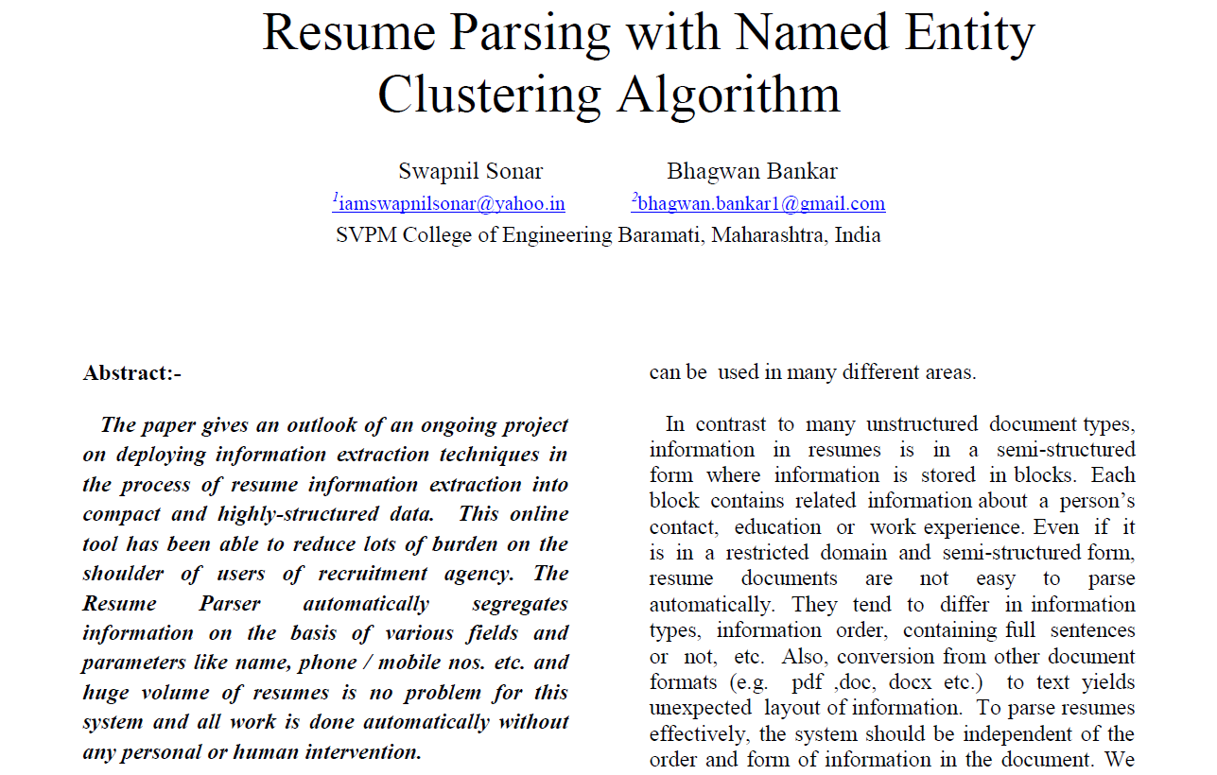
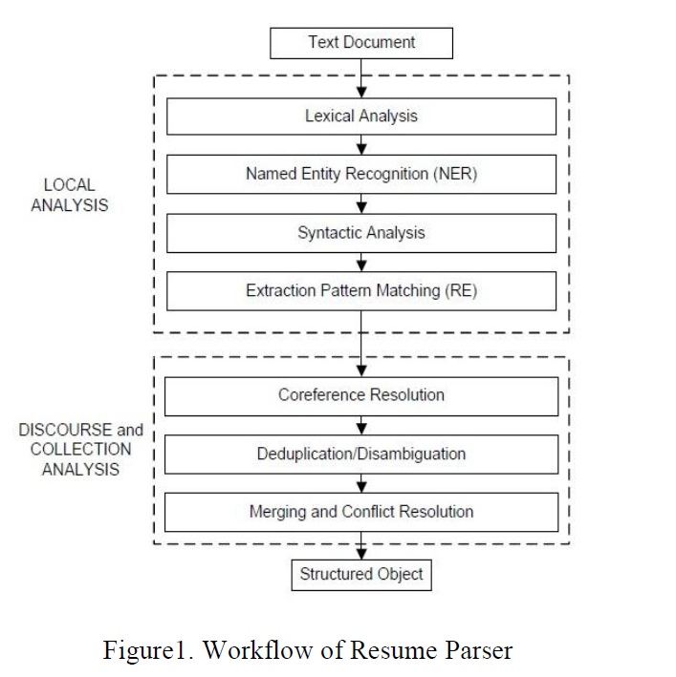
Related work - 1

Slide 5
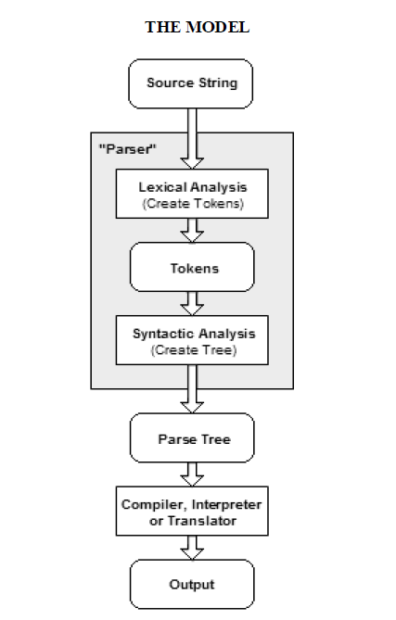
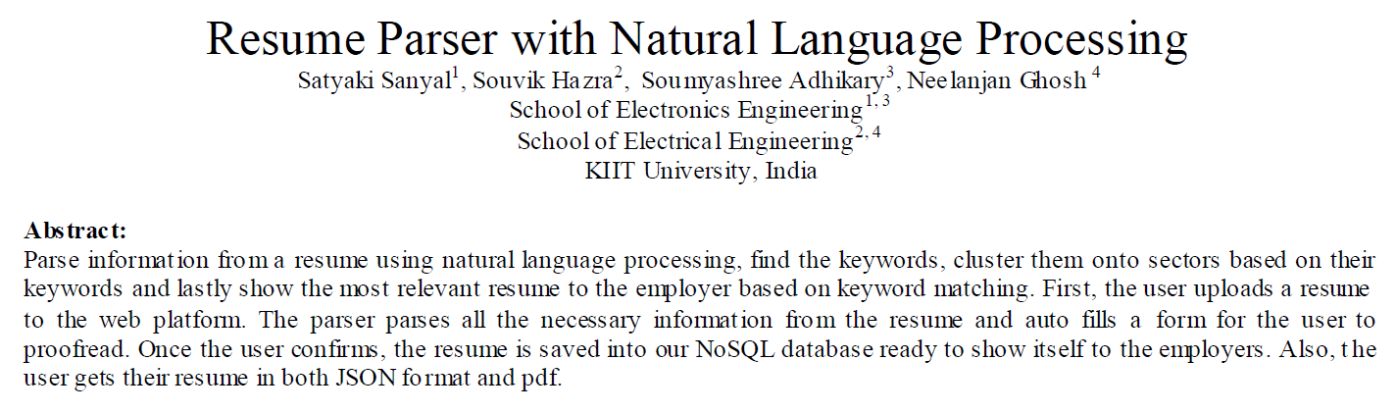
Related Work - 2

Slide 6
Datasets used
https://www.kaggle.com/dataturks/resume-entities-for-ner
https://drive.google.com/file/d/1uJjBRh5DPrqcSqNZL4dmsTzeQzu47kBz/view?usp=sharing

Slide 7
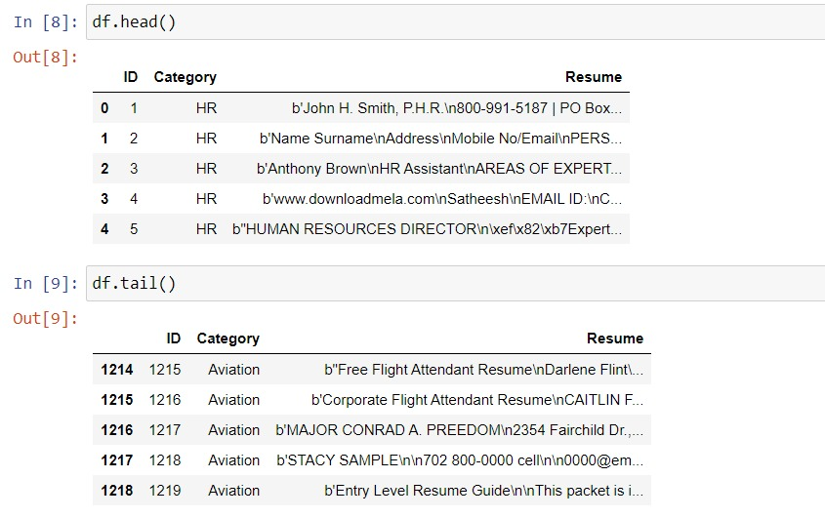
Raw Dataset

Slide 8
Proposed pipeline
Our pipeline can be divided into 5 stages
Our entire work flow can be divided into Data Pre processing, Vectorization of text, Training and comparing different models for classification, Selection of the best model, and finally Summarization.

Slide 9
Pre Processing
Data Cleaning : It included Conversion of encoding and removing of Unnecessary separators , Punctuation and Stop Words and Personal details
Class Labels : For added ease during further processing, mapping the class labels to numeric constants was done

Slide 10
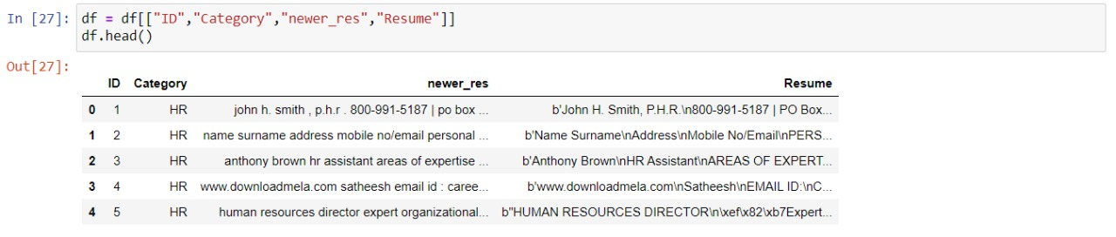
Dataset after Basic Cleaning

Slide 11
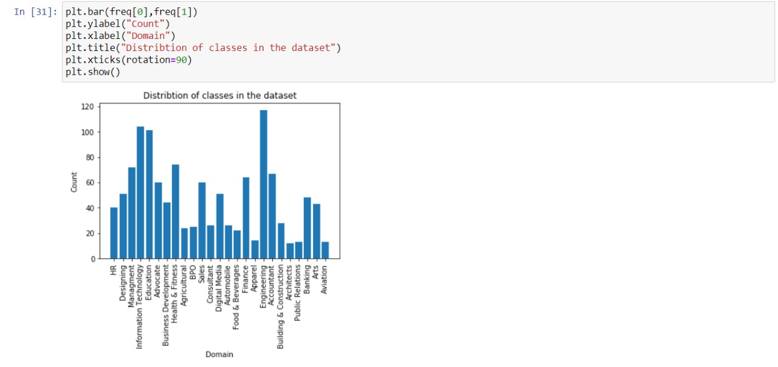
Analysis of the domain v/s its count

Slide 12
Vector Processing of Text
The classifiers and learning algorithms can not directly process the text documents in their original form
One common approach for extracting features from text is to use the bag of words model where the presence (and often the frequency) of words is taken into consideration, but the order in which they occur is ignored.
Term Frequency and Inverse Document Frequency is used for each document to create the vectors that represent the resume.

Slide 13
Input Representation for models
Word Counts with Count Vectorizer: It provides a simple way to tokenize a collection of documents, built a vocabulary of known words, and to encode new documents using that vocabulary
Word Frequencies with Tf-Idf Vectorizer: Term frequency summarizes how often a given word occurs within a document and Inverse document frequency down scales words that appear a lot across documents. The Tf-Idf Vectorizer will tokenize documents, learn the vocabulary and inverse document frequency weightings, and allow you to encode new documents

Slide 14
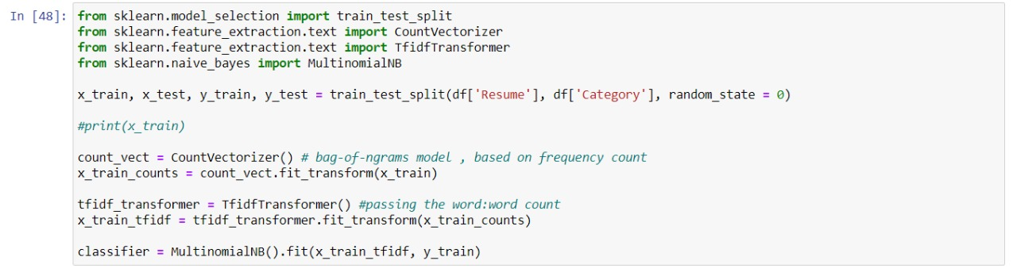
Preparing the data

Slide 15
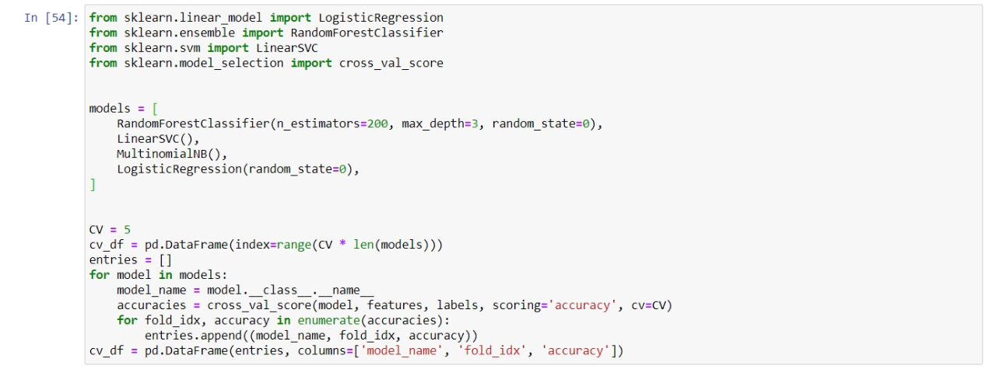
Comparison between model

Slide 16
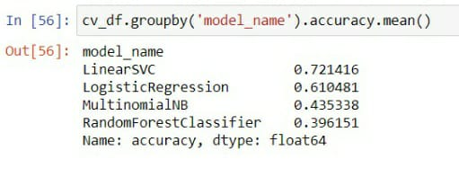
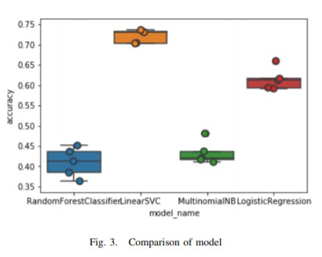
Model Selection
The models we used to compare the results were Support Vector Classifier, Logistic Regression, Naive Bayes and Random Forest. Amongst all the different models Random forest algorithm tends to perform worse and SVC performs the best with an average accuracy of 70%-75%

Slide 17
Model Accuracy
The SVC model from our inference must have performed the best merely due to the topology of this dataset. It does a better job of capturing non linearities than Bayes or Logistic regression. Also the SVM model originated from an optimization problem. This makes it work better than most other models on multivariate numeric data , which is the case with our vector representation of words.

Slide 18
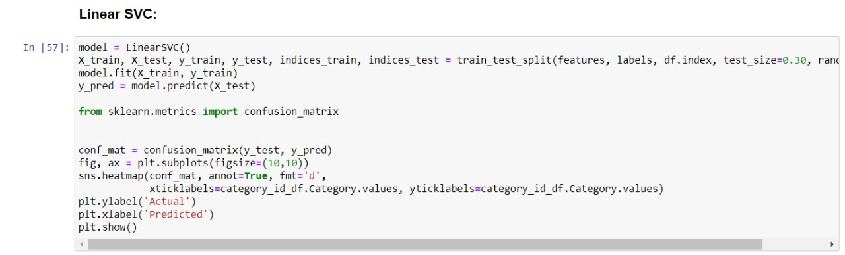
Training Using linear svc

Slide 19
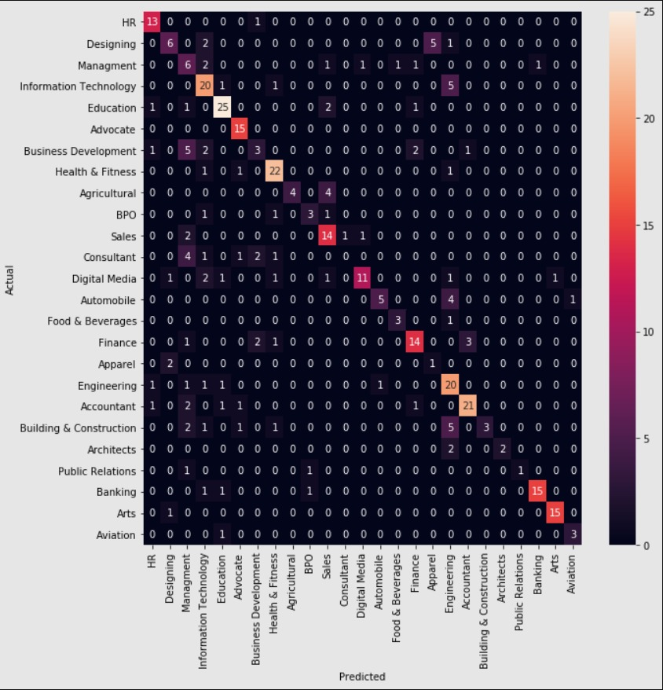
Final Prediction

Slide 20
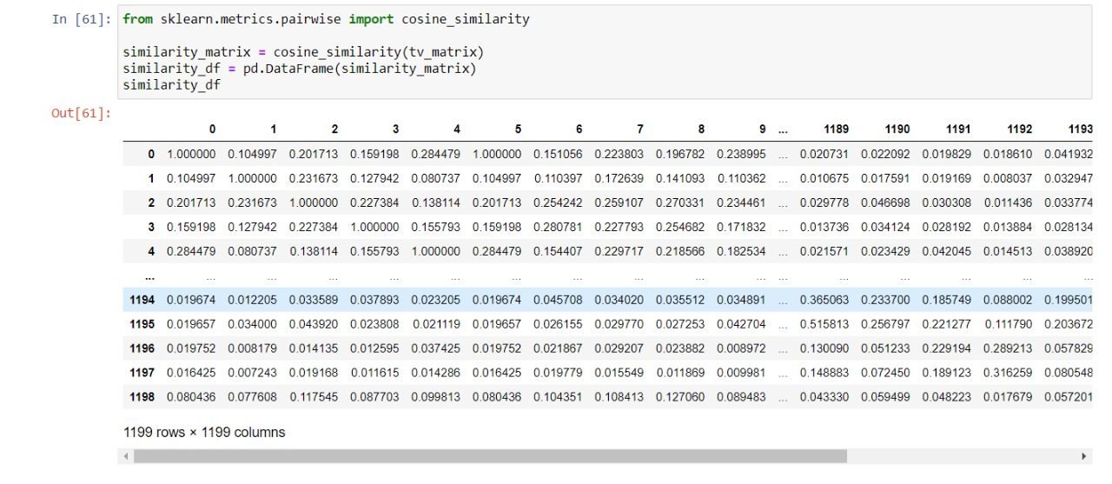
Finding Cosine Similarity

Slide 21
Summarization
Lexical token summarizer: It is a summarizer purely based out of scoring the sentences based on the words on the sentences
Algorithm Firstly, Sentence tokenization on the resume is carried out, then a frequency distribution of the words across the the resume at hand is generated. It is to be noted that prior to this step, removal of punctuation marks was done to prevent unnecessary noise. This frequency table was used to score the sentence.
The score of each sentence = Sum of the scores of each word in the sentence.The score of a word is the frequency count of the word in the resume.Finally, the summarized text is obtained by extracting the most significant sentences in the resume, based on the scores.

Slide 22
Team Members
JEHIL THAKKAR(18BIT043)
JAY BHAGIYA(18BIT040)
KATHAN PATHAK(18BIT051)
DEEP MISTRY(18BIT015)
MANVENDRA SHEKHAWAT(18BIT064)

